Slide 1

Shaking Things Up: Mastering React Component Library Optimization
Asaf Shochet Avida

Slide 2
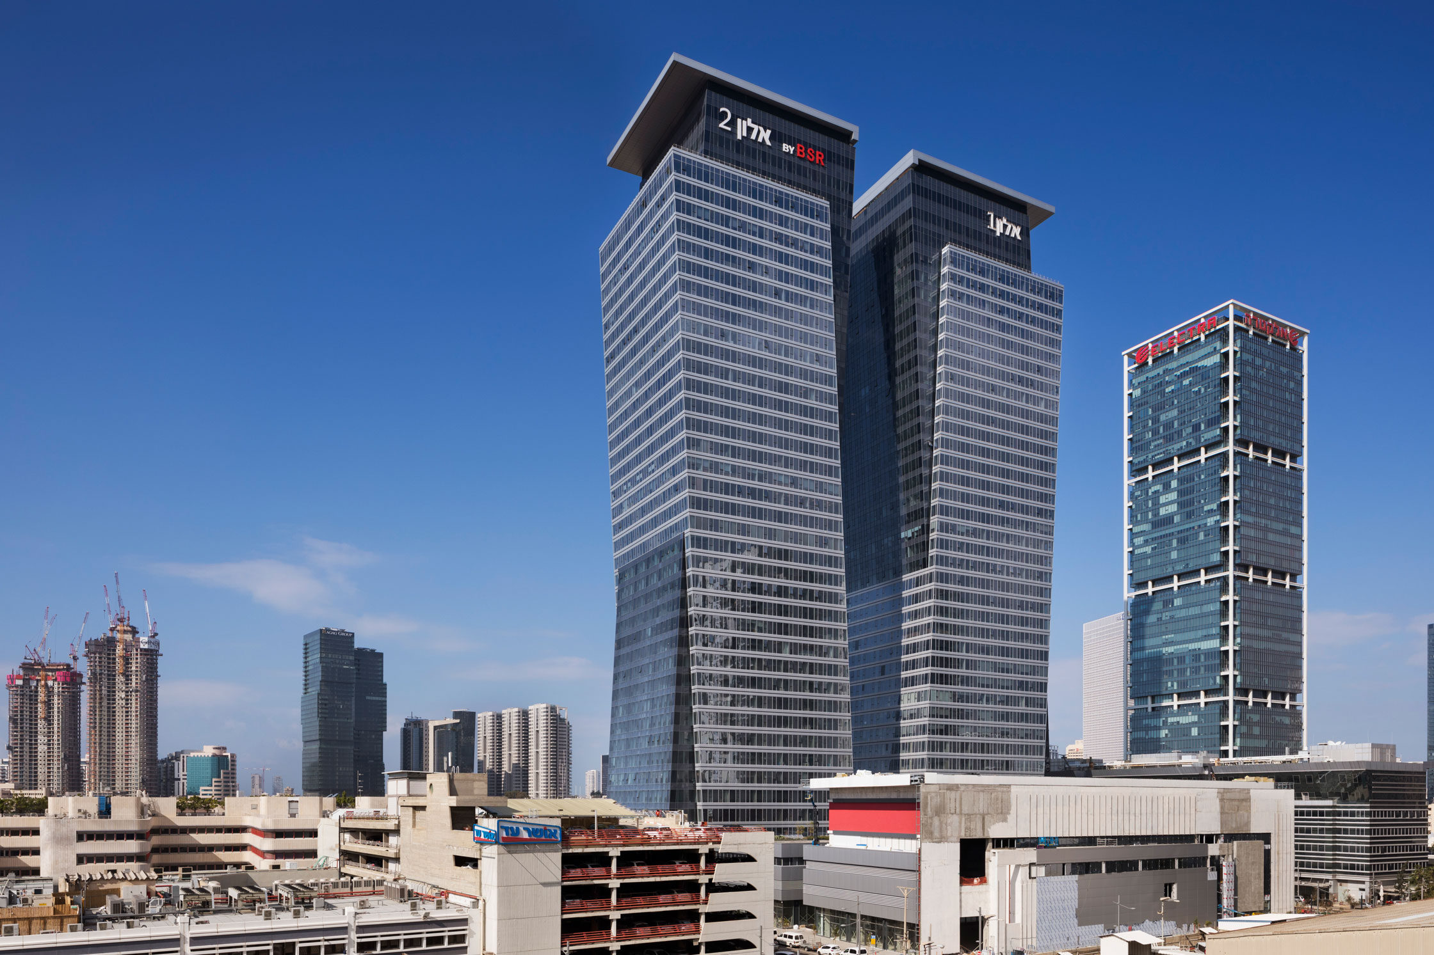
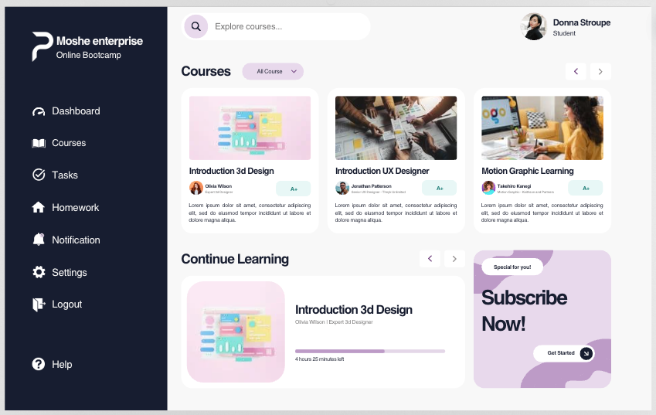
Imagine you’re in a startup
Notes:
3 Founders meet, create their first product, company grows, a second and thirs products are created. Engineering says – hey let’s create a component library with graphs, buttons, tables, loaders.
Yey! Say the founders
Product 4 steps in, needs only a button, imports the library, and BAM, the project works, but it’s a page with a single button, that weights 5MB. That’s not necessary!
Today we’re going to learn how to enjoy the richness of a component library, and the comfort of importing only parts of it.

Slide 3
Notes:
3 Founders meet, create their first product, company grows, a second and thirs products are created. Engineering says – hey let’s create a component library with graphs, buttons, tables, loaders.
Yey! Say the founders
Product 4 steps in, needs only a button, imports the library, and BAM, the project works, but it’s a page with a single button, that weights 5MB. That’s not necessary!
Today we’re going to learn how to enjoy the richness of a component library, and the comfort of importing only parts of it.

Slide 4

Notes:
3 Founders meet, create their first product, company grows, a second and thirs products are created. Engineering says – hey let’s create a component library with graphs, buttons, tables, loaders.
Yey! Say the founders
Product 4 steps in, needs only a button, imports the library, and BAM, the project works, but it’s a page with a single button, that weights 5MB. That’s not necessary!
Today we’re going to learn how to enjoy the richness of a component library, and the comfort of importing only parts of it.

Slide 5
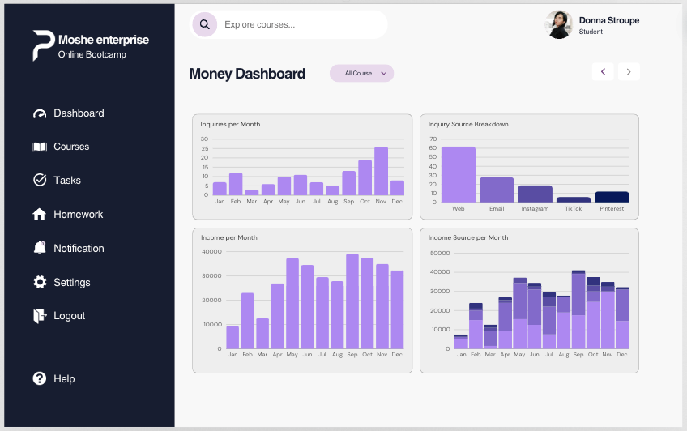
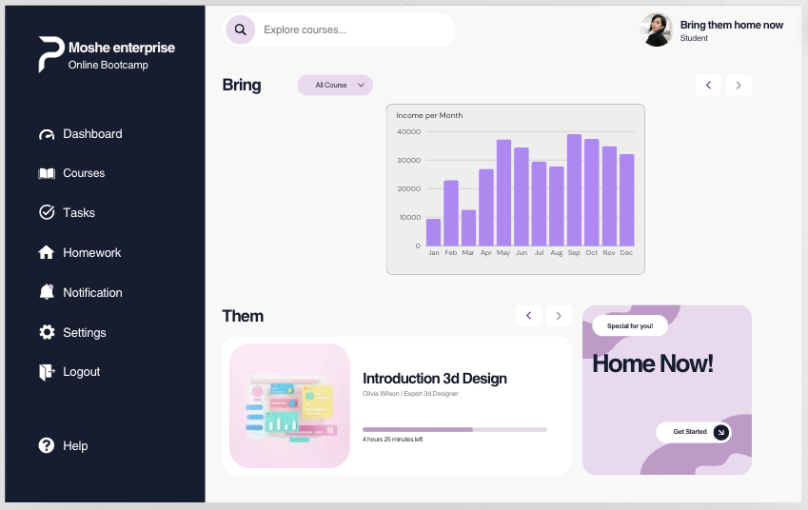
Company Grows
Notes:
3 Founders meet, create their first product, company grows, a second and thirs products are created. Engineering says – hey let’s create a component library with graphs, buttons, tables, loaders.
Yey! Say the founders
Product 4 steps in, needs only a button, imports the library, and BAM, the project works, but it’s a page with a single button, that weights 5MB. That’s not necessary!
Today we’re going to learn how to enjoy the richness of a component library, and the comfort of importing only parts of it.

Slide 6
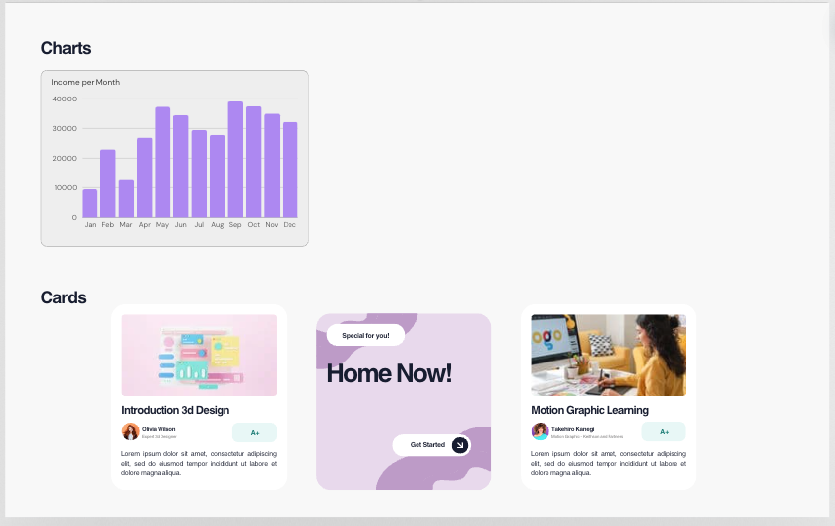
Enters the component library
Notes:
3 Founders meet, create their first product, company grows, a second and thirs products are created. Engineering says – hey let’s create a component library with graphs, buttons, tables, loaders.
Yey! Say the founders
Product 4 steps in, needs only a button, imports the library, and BAM, the project works, but it’s a page with a single button, that weights 5MB. That’s not necessary!
Today we’re going to learn how to enjoy the richness of a component library, and the comfort of importing only parts of it.

Slide 7
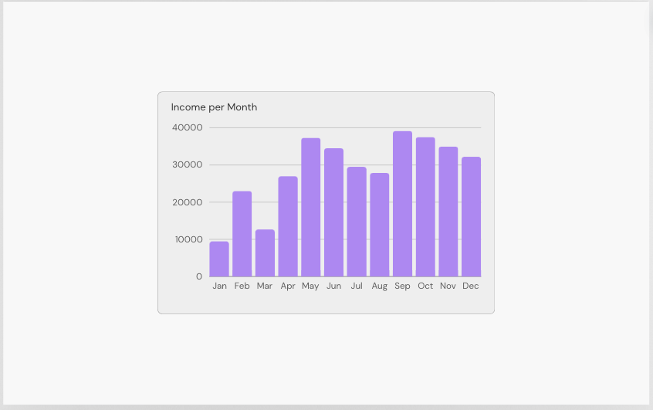
New App
5MB!
🙀
Notes:
3 Founders meet, create their first product, company grows, a second and thirs products are created. Engineering says – hey let’s create a component library with graphs, buttons, tables, loaders.
Yey! Say the founders
Product 4 steps in, needs only a button, imports the library, and BAM, the project works, but it’s a page with a single button, that weights 5MB. That’s not necessary!
Today we’re going to learn how to enjoy the richness of a component library, and the comfort of importing only parts of it.

Slide 8

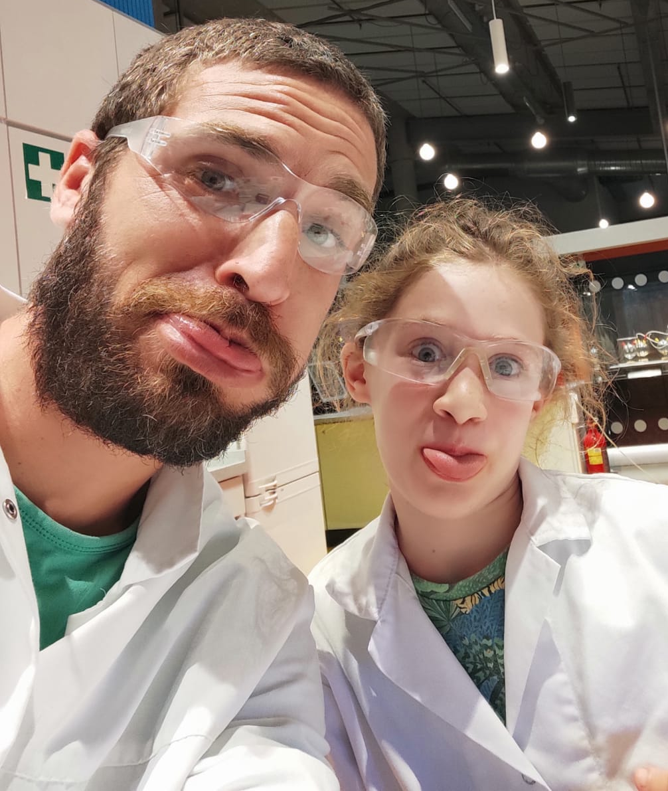


Speaker introduction
Asaf Shochet Avida
Frontend Tech Lead @Evinced
🌐
asaf-shochet frogrammer.net We Are Hiring!
Notes:
I’m the father of Eitan, Sahar and Aviv, Married to Neta
I’m the frontend tech lead at Evinced, an amazing startup the help large organizations make their apps and web apps accessible using technologies like AI, Computer vision to detect accessibility issues, accessibility web crawlers, and… web extensions, where I got familiar with this subject.
While working on our own chrome extensions, based on my interest in security, I started exploring the different capabilities chrome extensions have but from an attacker’s perspective, and that got me thinking.

Slide 9
Agenda
What is tree shaking?
Benefits
Optimize a component library )Coding)
Checklist
Touching Summary

Slide 10
What is tree shaking?
A technique to keep our product code concise by bundling only what’s needed

Slide 11

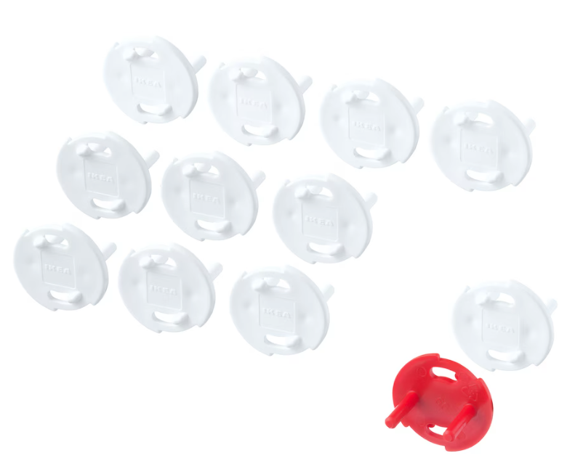
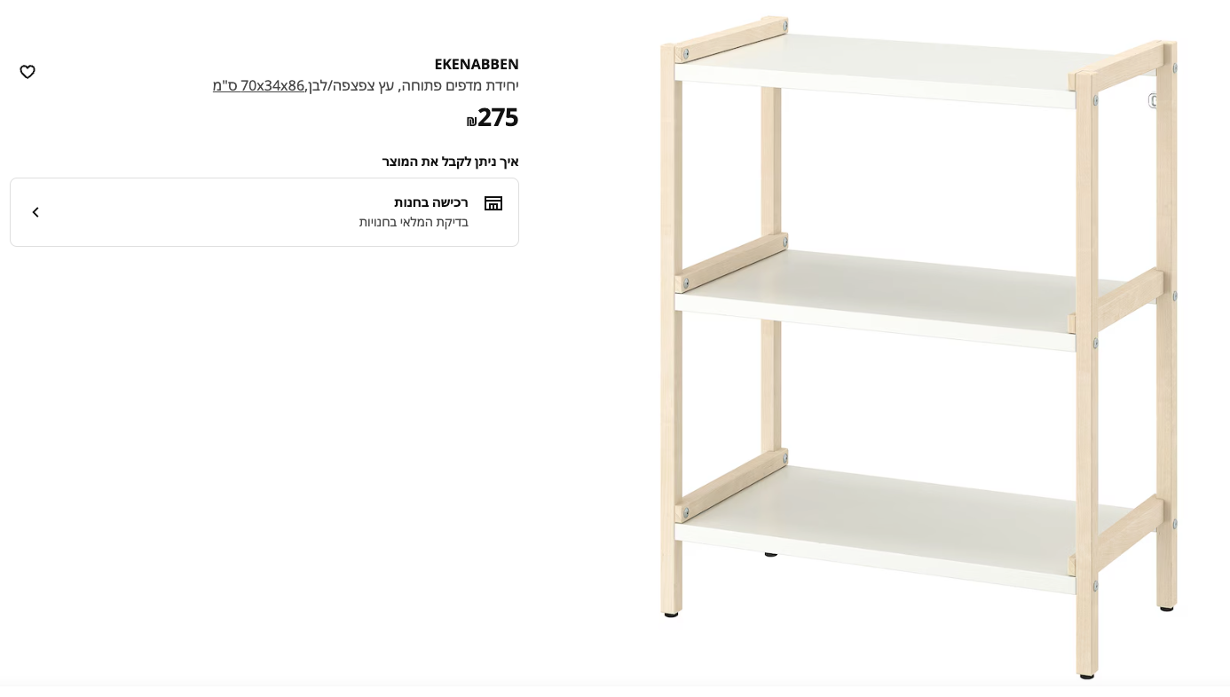
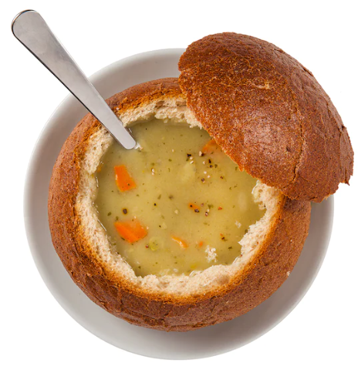
What is tree shaking?
A technique to keep our product code concise by bundling only what’s needed

Slide 12
Why?
1. Loading time
2. CPU (less to process)
3. Security
4. Unexpected bugs

Slide 13

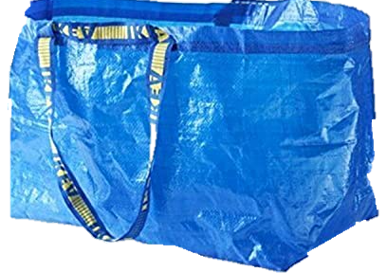
Javascript module systems
Common JS (CJS)
const foo = require(‘foo’);
Ecma Script Module (ESM)
import foo from ”Foo”;

Slide 14
And now
Let’s start coding! (Moving to code editor after this slide)
Code Code Code Code Code Code Code Code Code Code Code Code Code Code Code Code Code Code Code Code Code Code Code Code Code Code Code Code Code Code Code Code Code Code Code Code Code Code Code Code Code Code Code Code Code Code Code Code Code Code Code Code Code Code Code Code Code Code Code Code Code Code Code Code Code Code Code Code Code Code Code Code Code Code Code Code Code Code Code Code Code Code Code Code Code Code Code Code Code Code Code Code Code Code Code Code Code Code Code Code Code Code Code Code Code Code Code Code Code Code Code Code Code Code Code Code Code Code Code Code Code Code Code Code Code Code Code Code Code Code Code Code Code Code Code Code Code Code Code Code Code Code Code Code Code Code Code Code Code Code Code Code Code Code Code Code Code Code Code Code Code Code Code Code Code Code Code Code Code Code Code Code Code Code Code Code Code Code Code Code Code Code Code Code Code Code Code Code Code Code Code Code Code Code Code Code Code Code Code Code Code Code Code Code Code Code Code Code Code Code Code Code Code Code Code Code Code Code Code Code Code Code Code Code Code Code Code Code Code Code Code Code Code Code Code Code Code Code Code Code Code Code Code Code Code Code Code Code Code Code Code Code.
Code.
Notes:
Add a button
Show that the code is injected to the page, and send events
Track urls
=> go to a bank site
Listen to keyboard
Hijack data from local storage
Screenshots

Slide 15
Project structure
Let’s start coding! (Moving to code editor after this slide)
/consumer
react
webpack
/library
react
rollup
Notes:
Add a button
Show that the code is injected to the page, and send events
Track urls
=> go to a bank site
Listen to keyboard
Hijack data from local storage
Screenshots

Slide 16
1. Base
2. Output as module (package.json) + rollup
3. Named exports
4. Side Effects
5. lodash
Output as module
"module": "dist/src/index.js",
Change to named exports
Index.tsx + index.ts

Slide 17
Webpack
Modify cjs to esm
Change way to export
Define tree shaking on consumer
Production vs development
BundleAnalyzerPlugin

Slide 18
original
Export as esm
Named exports
Peer dependencies
Export with modules config

Slide 19
Tree Shaki(ng) easy as 1,2,3(ng)
Export library as ESM
Make modules independent
Prefer named exports (linter === ❤️)
Monitor size (it breaks easily)
Keep an eye on dependencies
Sometimes it doesn’t work

Slide 20
Touching Summary
Spoke about IKEA
Created a startup generator
Optimized it
This is not magic
5. Where to start?

Slide 21
Speaker introduction
Thanks for listening!
Asaf Shochet Avida
🌐
asaf-shochet frogrammer.net We Are Hiring
Notes:
I’m the father of Eitan, Sahar and Aviv, Married to Neta
I’m the frontend tech lead at Evinced, an amazing startup the help large organizations make their apps and web apps accessible using technologies like AI, Computer vision to detect accessibility issues, accessibility web crawlers, and… web extensions, where I got familiar with this subject.
While working on our own chrome extensions, based on my interest in security, I started exploring the different capabilities chrome extensions have but from an attacker’s perspective, and that got me thinking.

